Slide 1

Order Management and Inventory Software for J&J’s Kitchen Catering Co.
Presented By:
Ballerda, Steven Laurence B.
Fortez, Rich Ray C.
Mendoza, Lance Albert R. Peralta, Edward K.
Reyes, John Paul M.

Slide 2

THE CLIENT

Slide 3
The Client:
J&J Kitchen Catering Company was establish last June 2016.
A daughter company of RRA Food Services.
The J&J's Kitchen catering team is designed to serve the finest food they can offer to those who are planning events such as Weddings, Birthday Parties, Meetings, Corporate Events, Christening, Friends and Family Reunions and other similar events

Slide 4
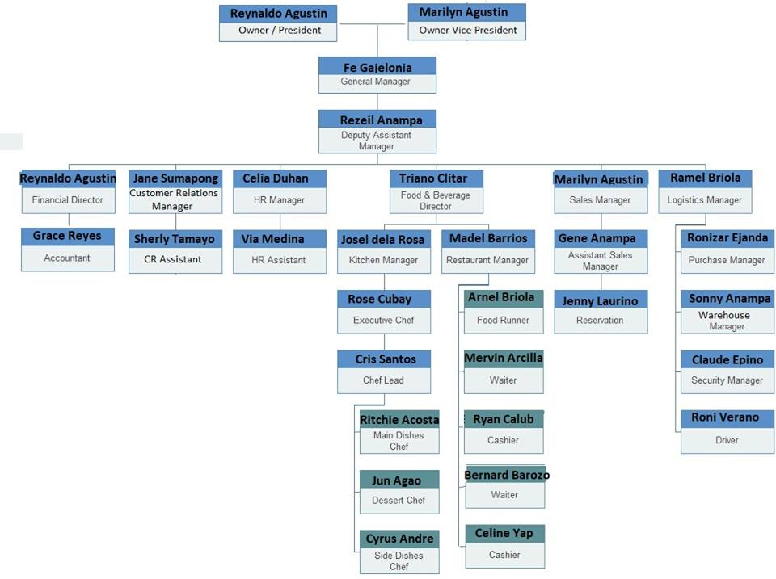

Slide 5
THE PROBLEM

Slide 6
What was Needed?
A Website for advertising and customer interactions
An Automated Inventory for ease in checking stocks
An Automated Order system to easily process orders

Slide 7
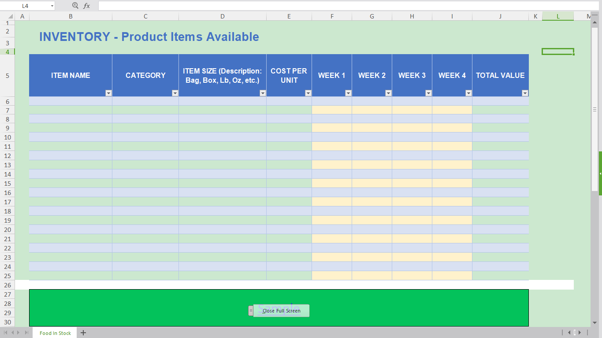

Slide 8
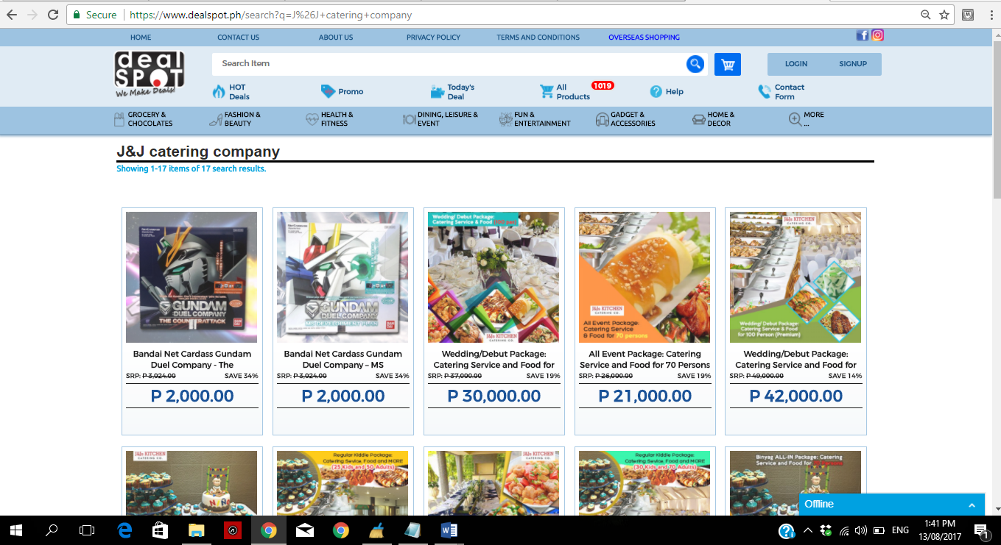

Slide 9
THE DESIGN

Slide 10
How was it made?
Website : HTML,CSS,PHP
Inventory: PHP, CSS, MYSQL
Order Management: VB

Slide 11
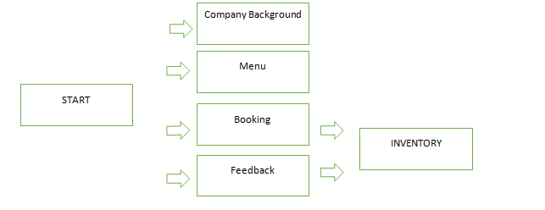
Website

Slide 12
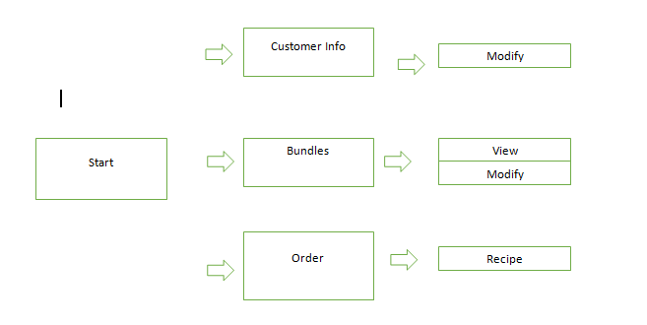
Order Management

Slide 13
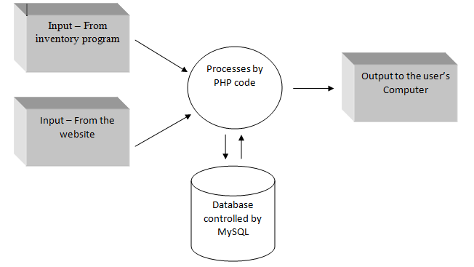
Inventory: Simplified Data Flow

Slide 14
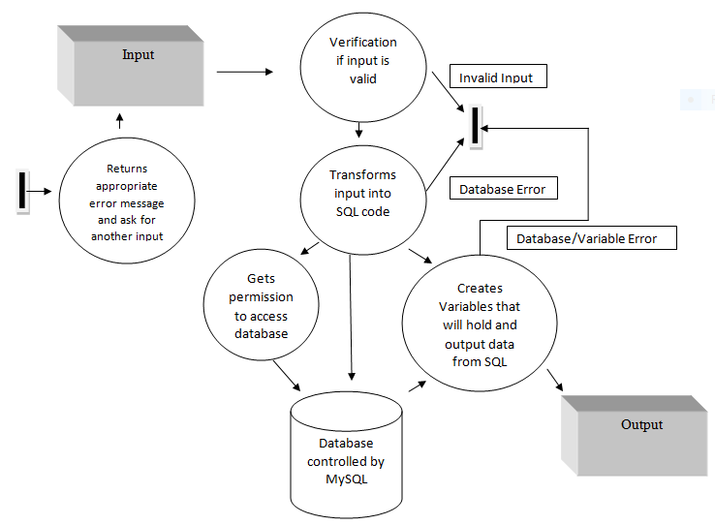
Inventory: Detailed Data Flow

Slide 15
THE PROGRAM

